Slide 1
Structured Query
Language
Debug
Shala

Slide 2
History of Sequel
Debug
Shala

Slide 3
Manual Sytem – 1950:
DATA STORAGE IN PAPER RECORD
Huge manpower
Unnecessary time wastage
Debug
Shala

Slide 4
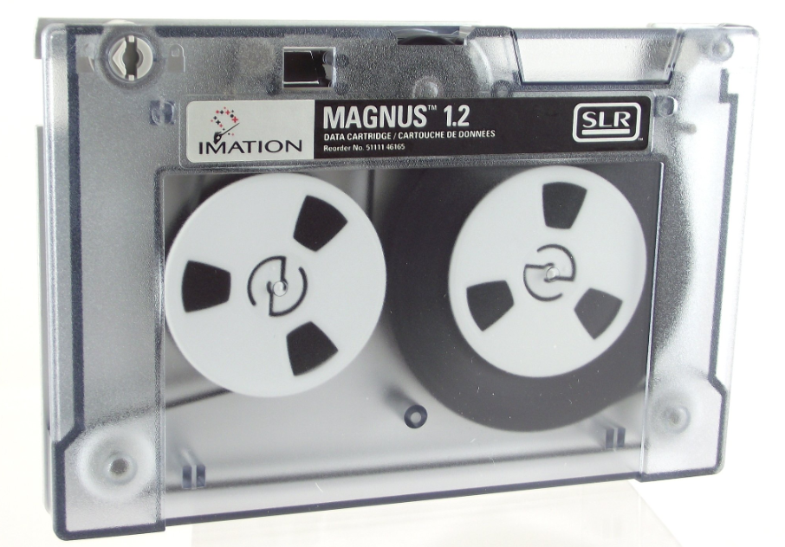
1950’s and early 1960’s
Data preprocessing used magnetic tapes for storage
Only sequenstial access
Punched cards for input
Debug
Shala

Slide 5
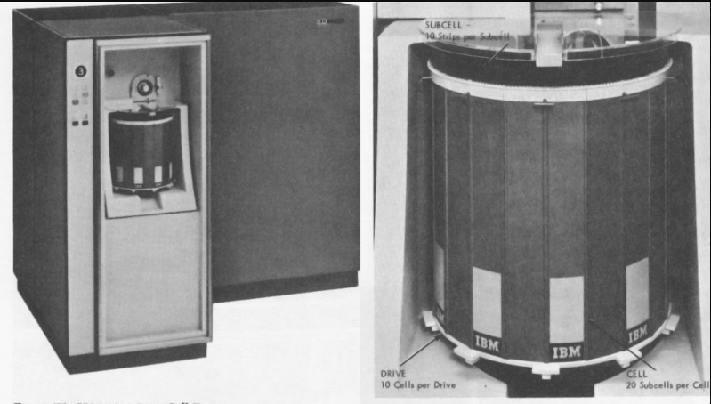
1960’s and 1970s
Hard disks allowed direct access to data
Data stored in files knows as file based system
Debug
Shala

Slide 6
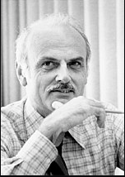
The Seeds of Relational Model (1970s)
1970: Dr. Edgar F. Codd publishes his seminal paper, "A Relational Model of Data”.
Key ideas: Codd's model introduced concepts like tables, columns, rows, and relationships, offering a logical and efficient way to organize data.
DR. Edgar f. codd
Debug
Shala

Slide 7
Birth of SEQUEL (Early 1970s)
Who Developed SQL ?
Donald D. Chamberlin and Raymond F. Boyce at IBM developed SEQUEL (Structured English Query Language) based on Codd's model.
Debug
Shala

Slide 8
Standardization takes Hold (1986)
1986: The American National Standards Institute (ANSI) and the International Organization for Standardization (ISO) officially adopt SQL as a standard, known as "Database Language SQL.“
Debug
Shala

Slide 9
Adoption of sequel in the Digital Age
Business intelligence: SQL became a core tool for data analysis and reporting.
Web development: enabling data storage, retrieval, and manipulation behind the scenes.
Scientific computing
Debug
Shala

Slide 10

Debug
Shala

